Slide 1

CS1BAC
Business Aspects of Computing
Unit 1 Introduction
Dr Alina Patelli, Dr Debaleena Roy
Original material prepared by Dr Sherazade Boussag

Slide 2
Business Aspects of Computing
Module Logistics

Slide 3
Module Tutors
Dr Alina Patelli
Senior Lecturer in Computer Science
email; office hours; MB265E
Dr Debaleena Roy
Teaching Fellow in Computer Science
email; office hours; MB265K

Slide 4
Business Aspects of Computing: Fundamentals
Business aspects of computing:
fundamental computing problems organisations are facing and their business implications
computing technologies typically used to build information systems (e.g., marketing and management applications)
business innovation, business intelligence, and decision making, as afforded by digital transformation (including Big Data technologies)
business analysis to determine if, what, and how information systems should be adopted by the organisation

Slide 5
Module Aims
Introduce management, marketing, and financial aspects of computing
Highlight the importance of computing in support of business strategies and innovation
Define and analyse business problems and computing solutions, and evaluate their success

Slide 6
Module Content
Unit 1: Introduction
Unit 2: Business Information Systems
Unit 3: Effective Group Work & Presentation Delivery
Unit 4: Requirements Analysis
Unit 5: IT Project Management
Unit 6: Business Process Management and Strategies
Unit 7: Data, Information, and Information Systems Characteristics
Unit 8: Communication in Information Systems. Application Integration

Slide 7
Module Delivery
Tutorials
Lectures
Independent study
Work through a task similar to the coursework.
Practical, interactive, residential and online.
Weekly: Mon (2 – 3 pm), Tue (9 – 10 am and 12:30 to 1:30 pm).
Consolidate concepts and skills applied in the tutorials.
Theoretical and practical, interactive, online.
Weekly: Wed (9 – 11 am).
In groups, apply the week’s concepts and skills to complete the relevant coursework element.

Slide 8
Module Assessments
Quizzes (50% of module mark)
Coursework (50% of module mark)
Assess your comprehension of units 1 through to 4 (first quiz) and of units 5 through to 8 (second quiz).
Each quiz is worth 25% of module mark.
On Blackboard. First quiz: Nov 1st (9 – 11 am), second quiz: Dec 6th (9 – 11 am).
Assesses your ability to apply the taught concepts and skills to a realistic scenario.
Report 37.5% of module mark, group work, in increments, Blackboard submission (Dec 15th, midnight).
Presentation 12.5% of module mark, group work, 2 checkpoints and final delivery (dates in brief), slides submission on Blackboard (Dec 15th, midnight).

Slide 9
Support and Feedback
Formative
Summative
Tutorial scenario follows the coursework structure: a worked example supporting the gradual completion of the group report and presentation.
Quiz marks measure command of coursework-relevant concepts and skills.
Checkpoints finish with personalised feedback from tutors. Use it to improve your coursework.
Written comments on your report. On Blackboard.
Verbal comments on your final presentation.
On demand support and feedback available during taught sessions and office hours.

Slide 10
Blackboard Walkthrough

Slide 11
Business Aspects of Computing
Introduction

Slide 12
The role of IT in business
Information technology is a crucial part of any company: monitor and manage
Analyse specific data to inform business decisions
Equip businesses with plentiful tools to overcome challenging business obstacles

Slide 13
The role of IT in business
Helping the company be more productive, time = money
Optimising business performance
Safeguarding data and troubleshooting
Improving customer experience, satisfaction and communication
Enhancing managerial decision-making
Helping the business expand globally
Providing staff access to company information

Slide 14
The need for IT in business
Explosion in commerce and trade
Traditional business models and concepts become obsolete
Greater efficiency for conducting business

Slide 15
Importance of IT in organisations
Business
Use it in different departments, including finance, manufacturing, human resources, and security
Finance
Increasing number of transactions happening online, need for more networks and greater security, making it possible for banks to keep purchases and sales secure
Security
With an increasing number of transactions being done online, there is an ever-increasing need for safety

Slide 16
Information Technology as a force for innovation
IT has helped businesses to operate more efficiently
Replace the postage stamp with a bar code
Some enterprises are fully reliant on IT
Social networks (Twitter), e-commerce (Amazon, eBay), streaming (Netflix, Disney+)

Slide 17
Business Information Systems
Types
Transaction processing systems (TPS)
Management information system (MIS)
Decision (executive) support system (DSS)
To design and implement the IS: Requirements analysis first
To monitor all the stages (from scoping, requirements analysis, coding, testing, deployment and maintenance): IT project management (Agile or Waterfall)

Slide 18
Business Information systems
An information system (IS) is an arrangement of people, data, processes, and information technology that interact to collect, process, store, and provide as output the information needed to support an organisation
Examples : ERP like SAP, CRM like Salesforce

Slide 19
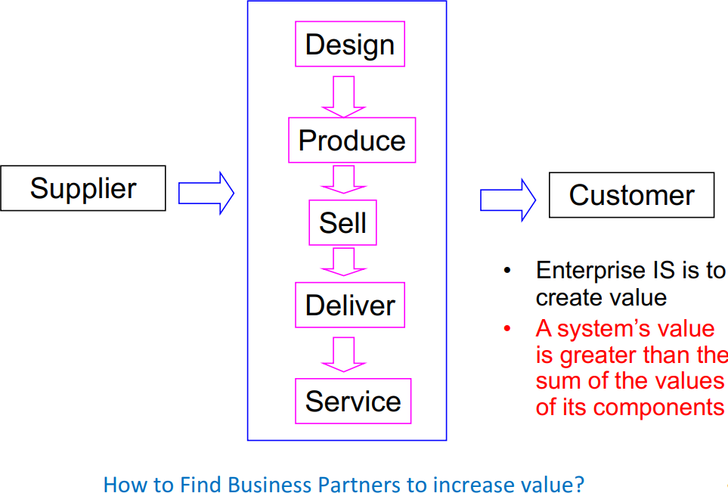
Transactional system and the Value Chain

Slide 20
Business aspects of computing covers different areas
Transactional systems also called Transaction processing systems (TPS) or Online transaction processing (OLTP)
Information system that captures and processes data about business transactions
Example : sales, receipts, payroll, etc..
Keep track of basic activities and transactions of organization (e.g. sales, receipts, cash deposits, payroll, credit decisions, flow of materials in a factory)

Slide 21
Business aspects of computing covers different areas
Decision/Business Intelligence system also called Management
information system (MIS)
provides for management-oriented reporting based on transaction processing and operations of the organization : Business intelligence reporting: monitor sales performance for ex
Decision/Executive support system (DSS)
Helps to identify decision making opportunities or provides information to help make decisions
Data analytics : predictive analytics , Business insights
=> Thanks to Big data

Slide 22
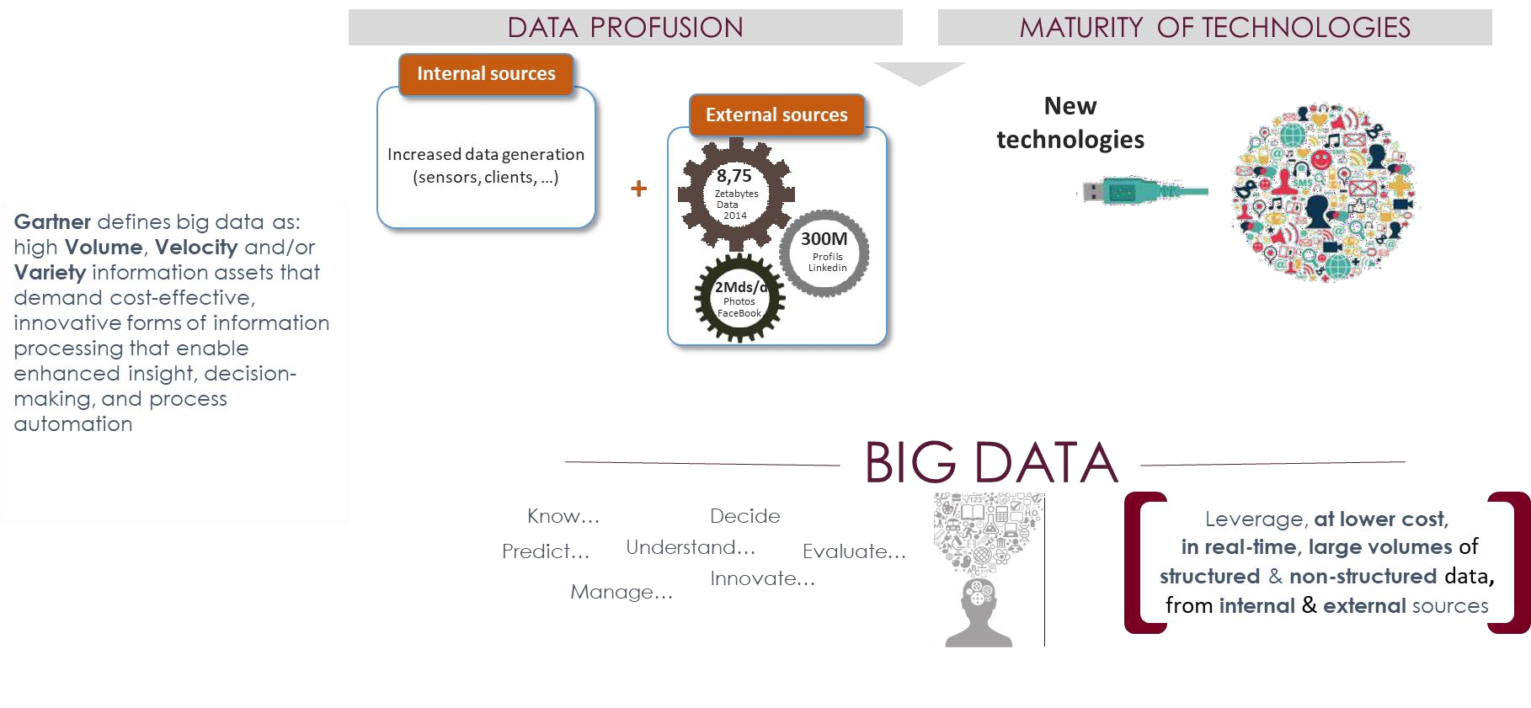
Big Data

Slide 23
Big Data
Big Data is defined by the “3 Vs”
Volume: Is there a high volume of data? (e.g. terabytes to petabytes per day)
Variety: Is data stored across multiple formats? (e.g. audios, videos, images,
media files, log files)
Velocity : how quickly data is generated and how quickly that data moves ? (e.g. per second, sub-second)
This ability leads to the “4th & 5th V” of Big Data
Value: Valuable insights gained from data
Veracity : Trust in the accuracy, quality

Slide 24
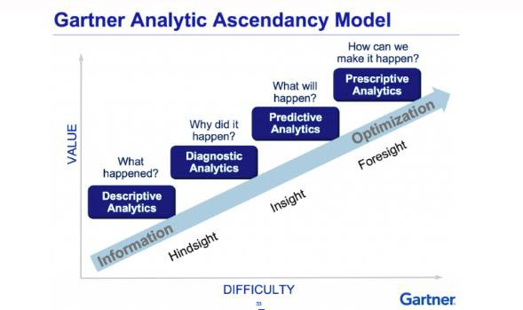
What is Big Data Analytics
Definition
Complex process of examining Big Data sets which features are volume, velocity and variety
Gartner offers its own definition of “analytics”, within which an inherent
aspect of future forecasting is also embedded
Big data analytics
Hindsight – What happened ?
Oversight – What is happening ?
Insight - Why is it happening?
Foresight – What will happen ?

Slide 25
What is Big Data Analytics
Techniques
Making prediction thanks to predictive analytics through Machine Learning
ML is a branch of artificial intelligence (AI) and a method of data analysis that automates big data analytic model building to predict an outcome
Machine Learning is the best way to exploit the opportunity presented by
Big Data : leverages algorithms to analyse vast amounts of data
Create programs and software that can learn to make predictions and
decisions without being directly programmed to do so

Slide 26








Big Data analytics applications domains
E-health
Retail
Smart Grid
case
BIG DATA APPLICATIONS
Political services & government monitoring
Internet of Things (IoT)
Transports & logistics
Public utilities

Slide 27
Big Data analytics uses cases
Customer analytics
Creating 360-degree customer view
Delivering personalised customer experience
Segmenting customers based on behaviour patterns
Preventing customer churn
Analysing customer sentiments

Slide 28
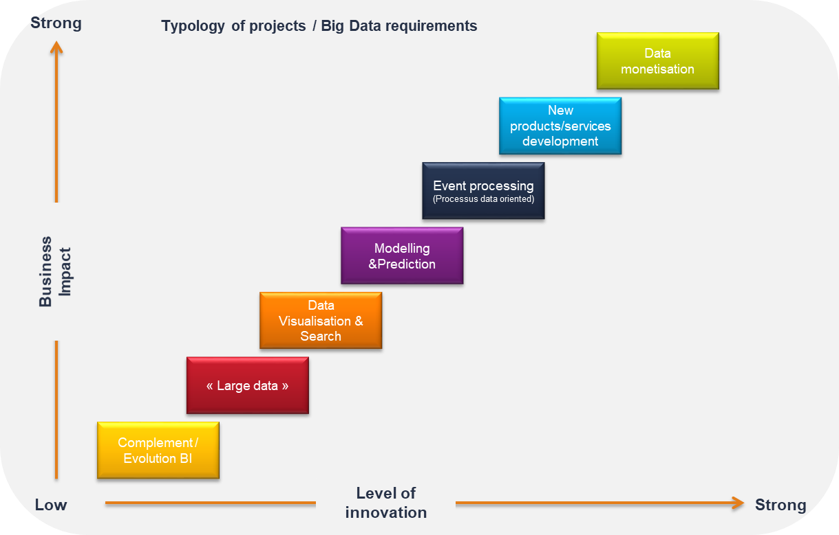
Big Data analytics & Data driven companies
Data driven company

Slide 29
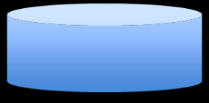
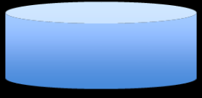



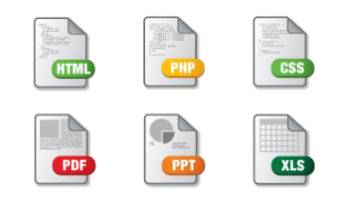





Business Information System – BI & Big data analytics
TPS
Business intelligence reporting Descriptive : The total sales per store and/or product category
Operating
systems
per month
SAP
MIS
Salesforce
Data Mart
External data
DSS
Analytic Mart
Big Data: SQL and
NotSQL data
Predictive analytics Business Insights Predict the sales
Predict the customer churn

Slide 30
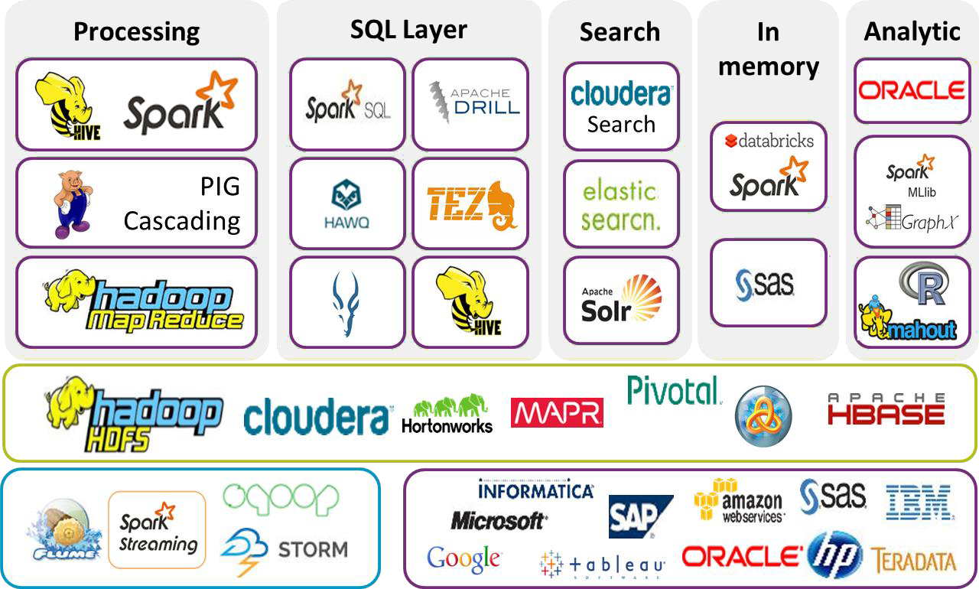
Big Data analytics software on the market Hadoop/Spark ecosystem

Slide 31
Obstacles
Major IT projects have a history of cost overruns and unsatisfactory performance
WHY?
Unrealistic expectations – Executives with little understanding of IT
negotiate with suppliers over keen to win contracts
Difficulty in implementing IT-based solutions – Large IT systems are inherently complex
Difficulty in integrating IT into existing system – Solution: Redesign the system as a whole and don’t simply bolt new technology into an existing system

Slide 32
Obstacles
Resistance to change
Fear of losing job
Reluctance to learn new skills
BUT
Over enthusiasm for exciting new technology may
produce excessively complex systems
– Use simply approach to solve problem

Slide 33
Critical Success Factors
The Standish Group report 83.9% of IT projects partially or
completely fail
The top five factors found in successful projects are:
User involvement
Executive management support
Clear Statement of Requirements
Proper planning
Realistic expectations

Slide 34
Standish Group report 2019
The top five indicators found in challenged projects are:
Lack of user input
Incomplete Requirements & Specifications
Changing Requirements & Specifications
Lack of executive support
Technical incompetence

Slide 35
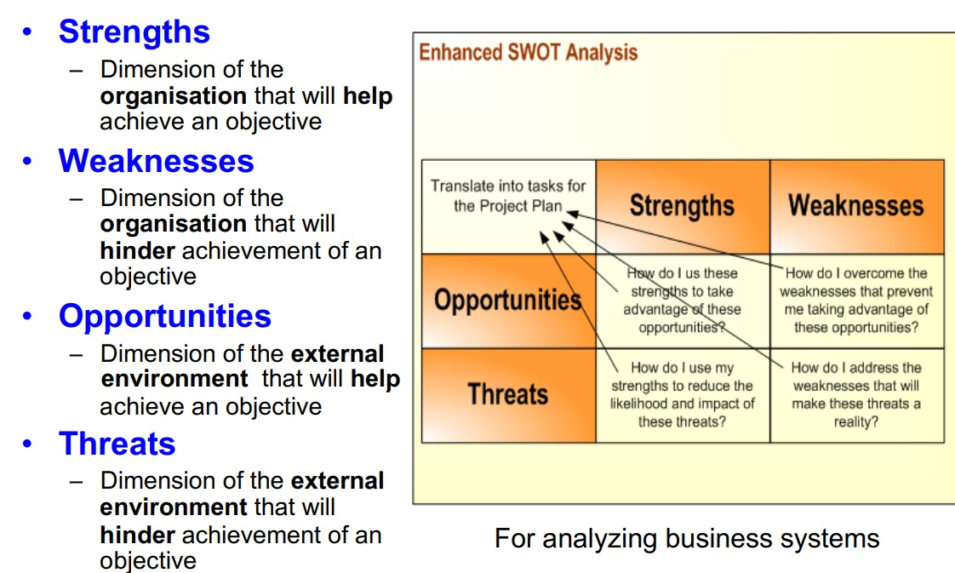
Assessing and analysing your Business information system through SWOT Analysis

Slide 36
Quiz
Q1 : The role of IT in business is
Helping the company be more productive and performant
Safeguarding data
Supporting business decisions
All of the above

Slide 37
Quiz
Q2 : Transaction processing systems (TPS) aims at
providing information to help make decisions
True
False

Slide 38
Quiz
Q3 : Predictive analytics is a process of examining and leveraging Big Data to find out hidden patterns, correlations between data, market trends and customer preferences in order to predict an outcome
True
False

Slide 39
Quiz
Q4 : A data driven company is a company who:
Create new products and services
Monetise its data
Is productive
All of the above

Slide 40
Quiz
Q5 : Agile framework is meant for Information systems
projects with:
Low degree of complexity
Aggressive deadlines
None of the above

